Slide 1
The Logic of Business Governance and Sustainability
Long-term versus short-term

Slide 2
There are many stakeholders in the context of sustainability but they could be divided into 2 main categories:
Environmentalists (including public institutions, pressure groups, governments, scientists and the public at large )
The Business Community

Slide 3
all stakeholders want to do the “right thing” but what is the right thing ?

Slide 4
There are fundamental differences between the way business, on the one hand, and environmentalists, on the other hand, see the world

Slide 5
Role of business
Time
Focus
Risk
Role of government
Purpose

Slide 6
The starting point
Business Logic: business has built the modern world and we owe our well being to its incredible advances.
Environmental logic: the negative impacts of some businesses are unacceptable regardless of their importance

Slide 7
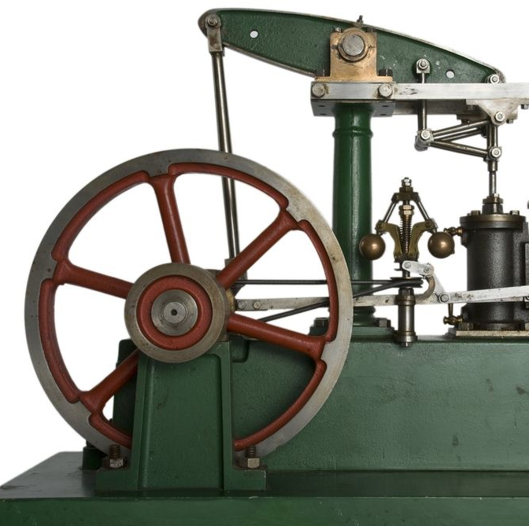
Business has been a force for good
James Watt improve Thomas Newcomen’s steam engine: Energy, electricity, light bulbs, steel, railways etc

Slide 8
Henry Ford invented the modern motor car

Slide 9
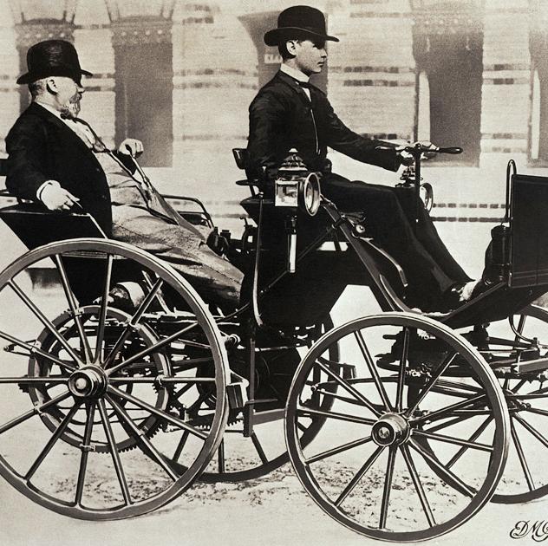
The early car

Slide 10
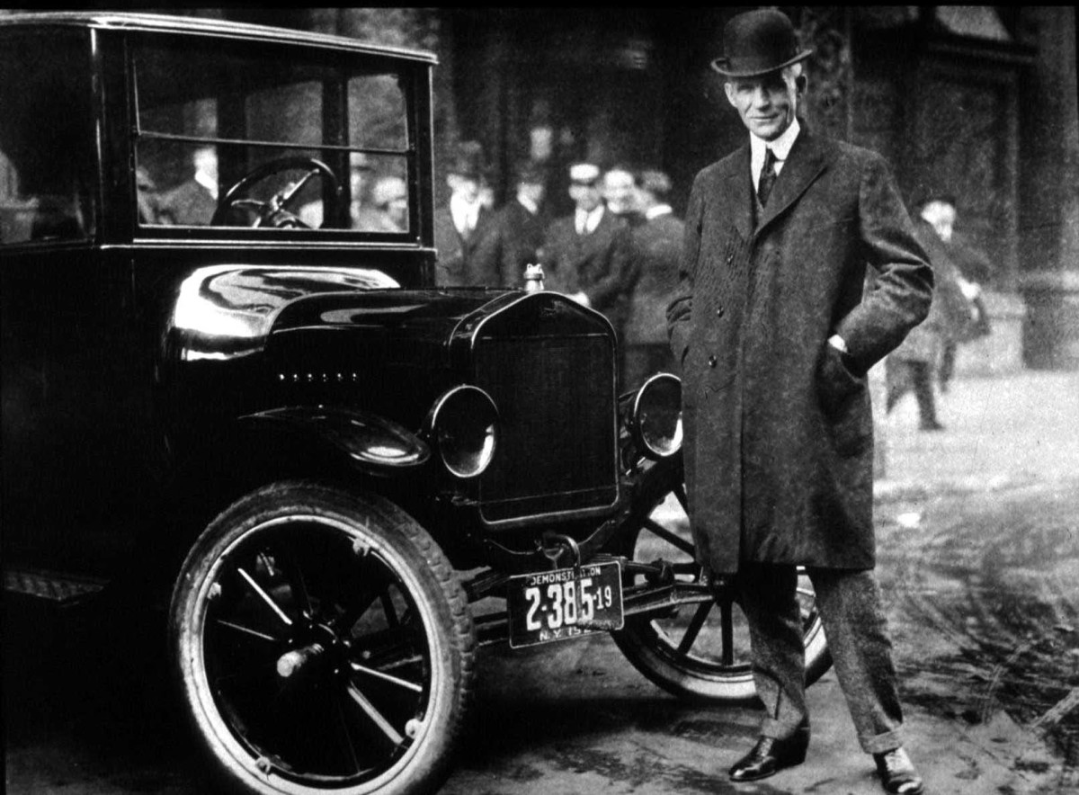
Ford

Slide 11
Hewlett and Packard were the founders of Silicon Valley that gave rise to the digital world that we enjoy today

Slide 12
Around the globe there are many entrepreneurs/companies that touched the lives of many people:
Lakhmi Mittal
Tata (India)
Aliko Dangote (Nigeria)

Slide 13
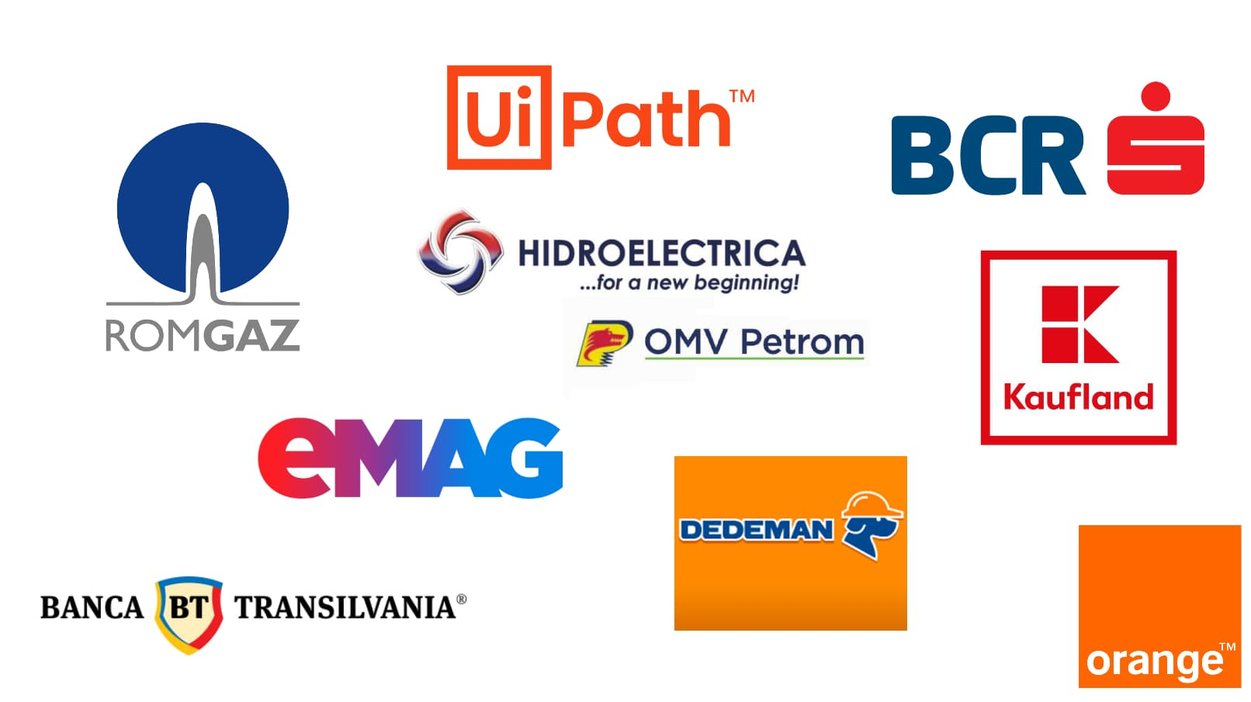

Slide 14
The home we live in, the food we eat, the clothes we wear ,the cars we drive , and the electricity and gas and oil …….

Slide 15
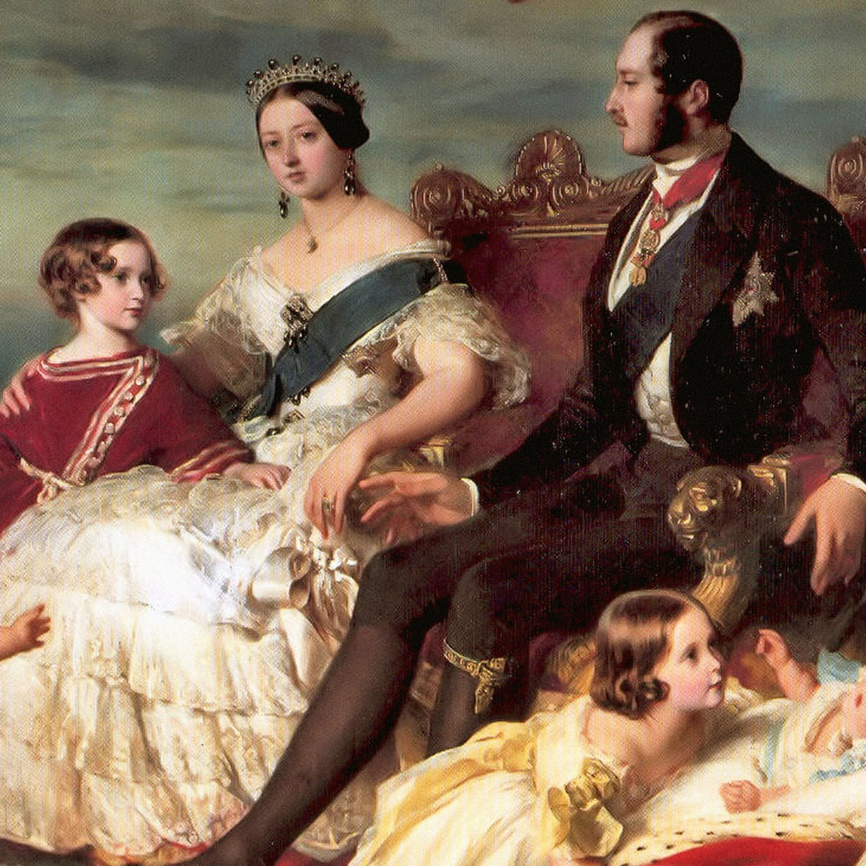
Our standard of living could not even be dreamt of by former Kings and Queens

Slide 16
However, “society has strong but often conflicted attitudes towards business in the sustainability contexts” (Blowfield, p.59)

Slide 17
Business has come under attack for waste and exploitation

Slide 18


Slide 19


Slide 20
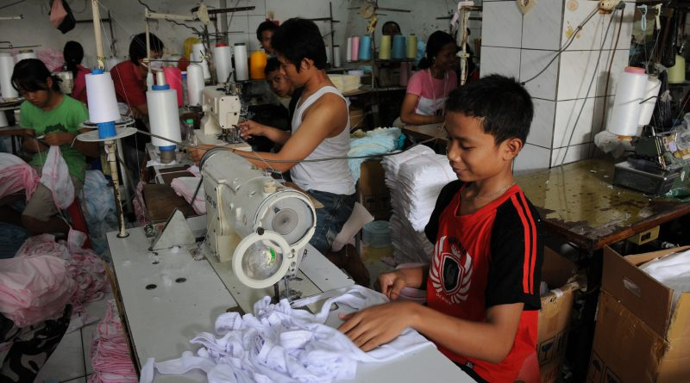

Slide 21
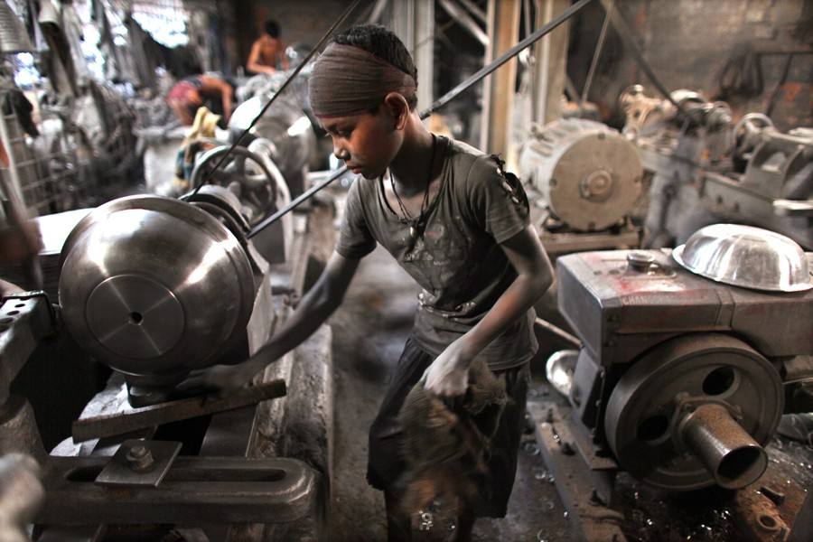

Slide 22
High emission industries : steel, aviation, oil, gas

Slide 23
Business fosters consumption :
“Affluenza”: greed, avarice
Psychologists, marketers and economists have all noted how consumer goods are not simply a good in their own right, but provide a symbolic language through which we communicate status, friendship , purpose, and affinity.

Slide 24
Semiotics: Science that studies signs and symbols

Slide 25

Picasso and Cubism

Slide 26
CONNOTATION: the painting represents the face of a crying woman, and it expresses her inconsolable pain. She is seen from different perspectives at the same time. The central area of the mouth and the eyes are painted in blue and white and they look like a broken mirror. The mouth appears through the hands that are covering it, as if it was impossible to hide the woman’s pain. She’s wearing an elegant red hat, probably a sign of a happier life in the past. She’s a symbol of the infinite human suffering caused by the war.

Slide 27
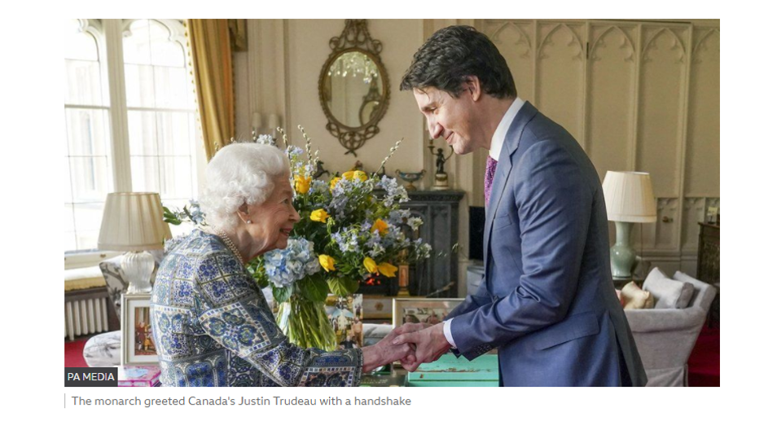

Slide 28
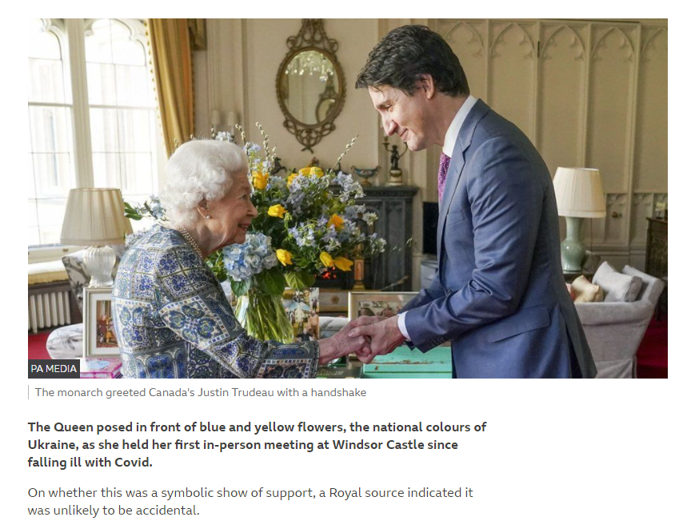

Slide 29
Marketing is becoming more aggressive

Slide 30
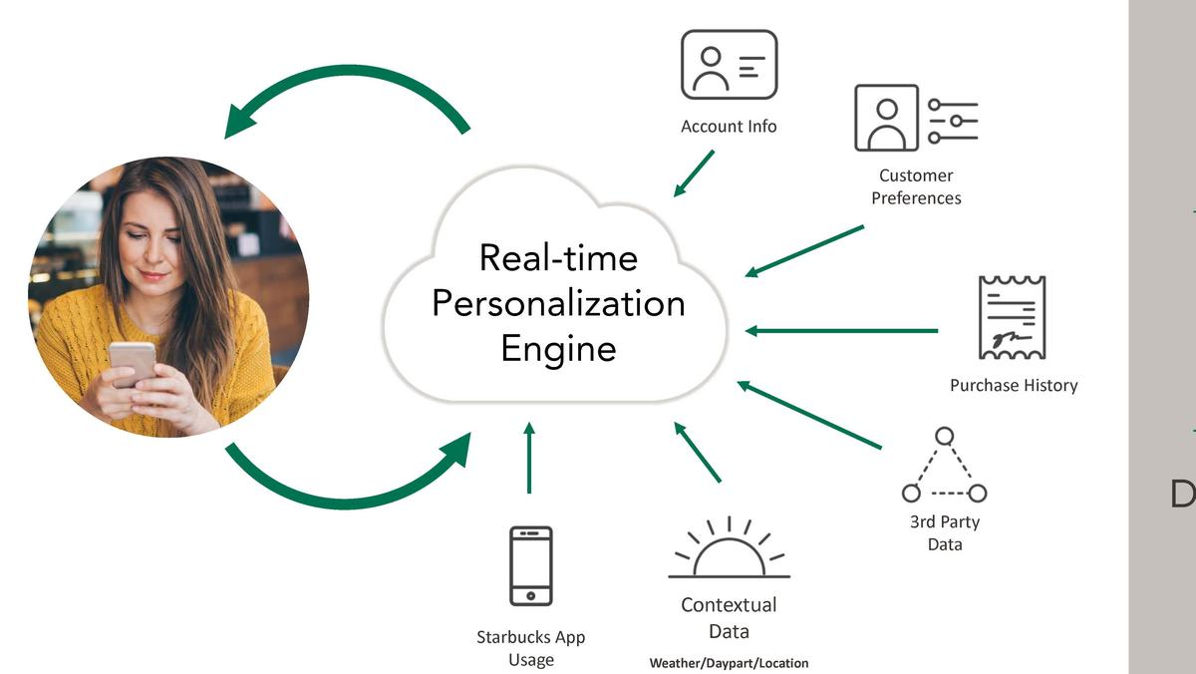

Slide 31



Slide 32


Slide 33


Slide 34


Slide 35

Created an app

Slide 36


Slide 37
Business fosters consumption :
“Affluenza”: greed, avarice
Psychologists, marketers an economists have all noted how consumer goods are not simply a good in their own right, but provide a symbolic language through which we communicate status, friendship , purpose, an affinity.

Slide 38
Beyond a certain point wealth is not associated with genuine prosperity

Slide 39
There are fundamental differences between the way business, on the one hand, and environmentalists, on the other hand, see the world

Slide 40
Role of business
Time
Focus
Risk
Role of government
Purpose

Slide 41
Time
Business Logic: with some exceptions 3 to 5 years is a relevant planning horizon and many decisions are even shorter term
Environmental Logic: Pollution and climate change will impact future generations and must be managed over decades or longer

Slide 42
One of the cornerstones of business logic is the time value of money

Slide 43
The typical discount rate is 10 to 15%

Slide 44
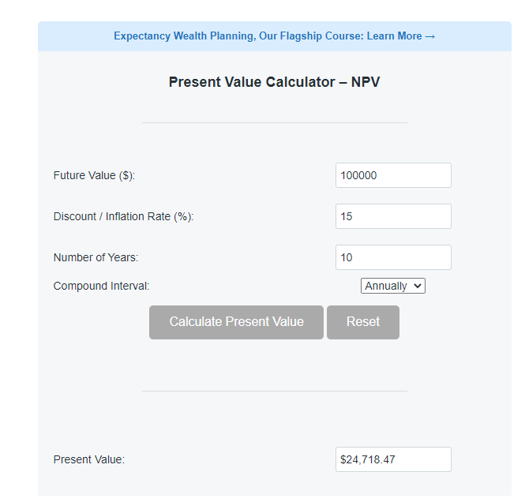

Slide 45
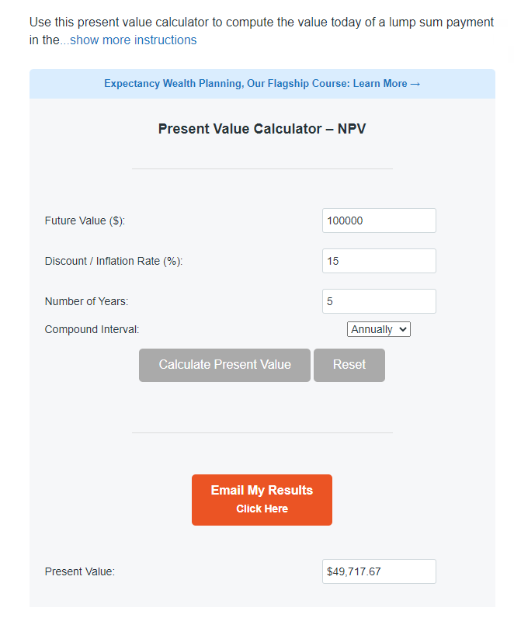

Slide 46
The value of any future cash flow drops off very quickly after the first five or ten years of a new investment or activity

Slide 47
Danish economist Bjorn Borg concludes that the cost of attempting to slow the pace of climate change is simply not worth the money
The world and its population would be better off with a different set of near-term priorities

Slide 48
For example, a 1 metre rise in sea levels would devastate Bangladesh and displace tens of millions.

Slide 49
Zeeland region of the Netherlands is, on the other hand, already below sea level and the Dutch have no problem maintaining the system of dykes because they are well off

Slide 50
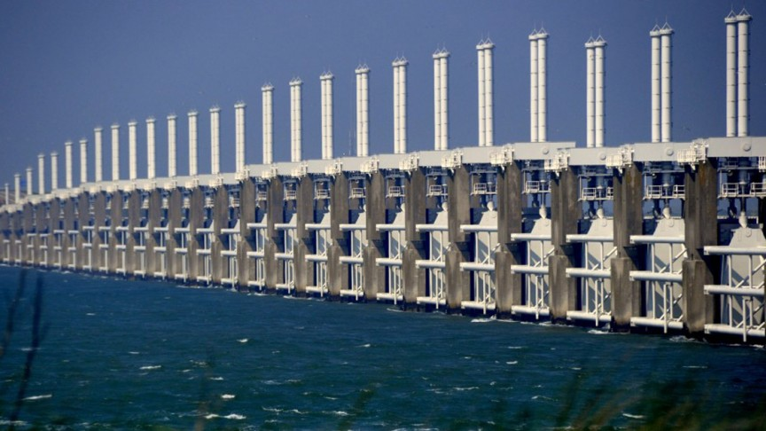

Slide 51
Time also concerns strategic planning

Slide 52
Strategic planning deals with three periods
short term cycles: sales, production, headcount

Slide 53
Medium 2 to 5 years: how to compete? where to compete?
Long term 5 to 10 years: few firms have developed rigorous processes for developing long term plans

Slide 54
Complexity
Managers face a complex overload of information
This may affect their perception
Use “heuristics” (short-cut in logic) to make decisions

Slide 55
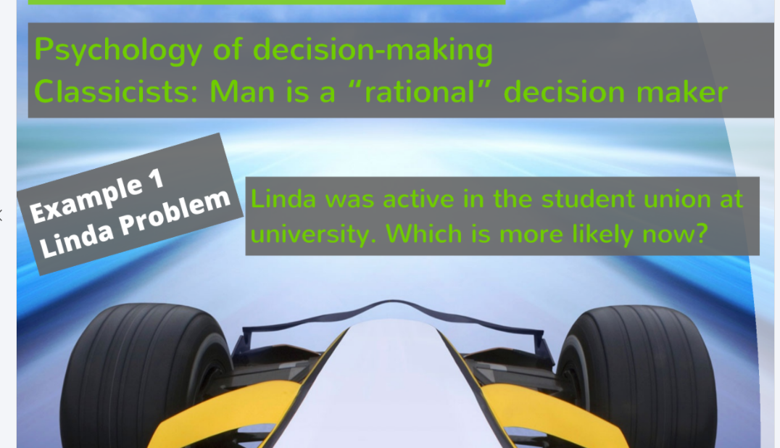

Slide 56
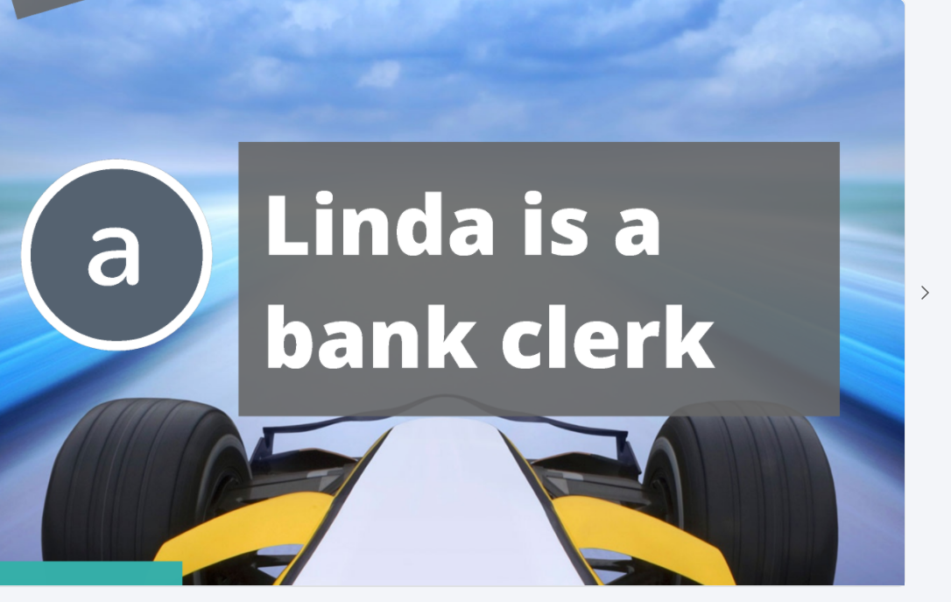

Slide 57
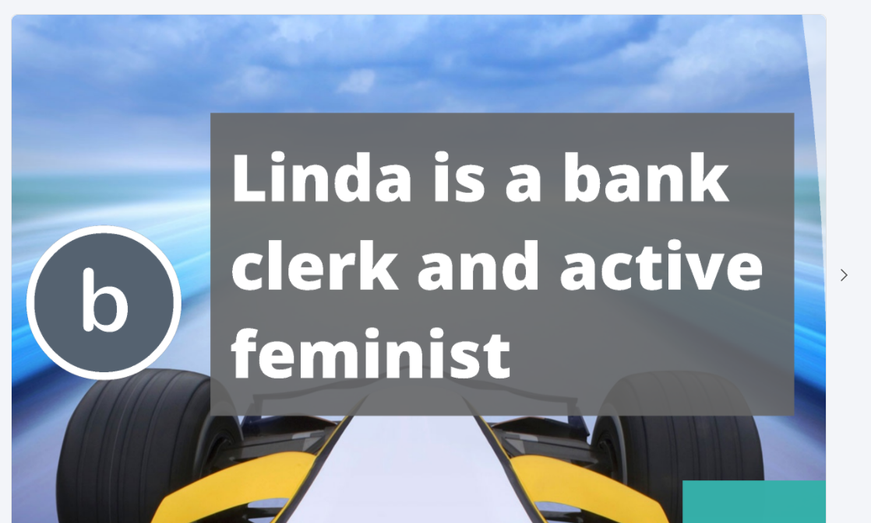

Slide 58
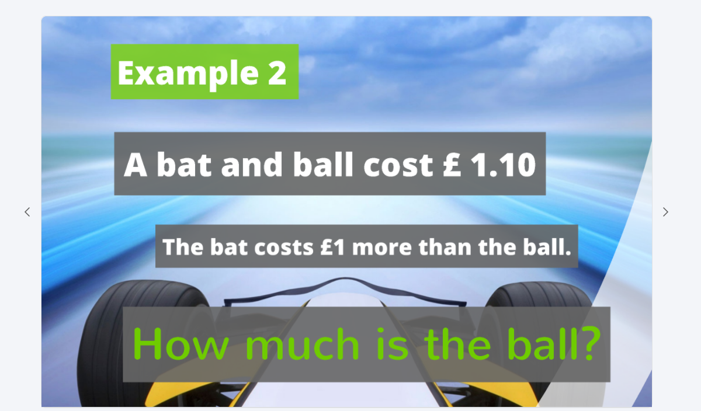

Slide 59
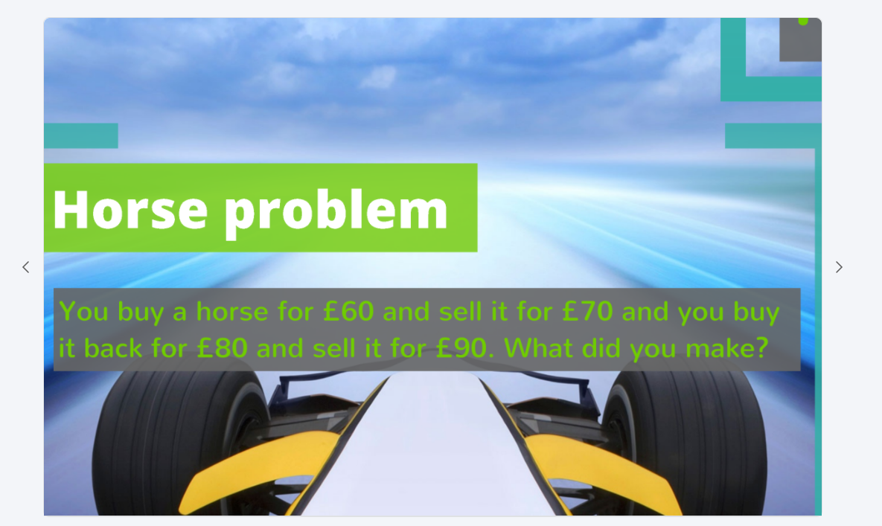

Slide 60
Erin Brockovich

Slide 61
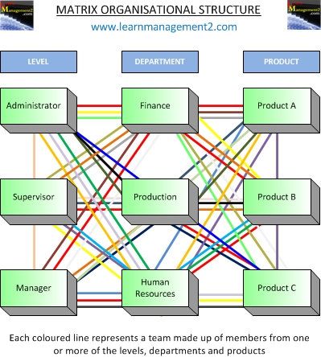
Structural matrix increases complexity

Slide 62
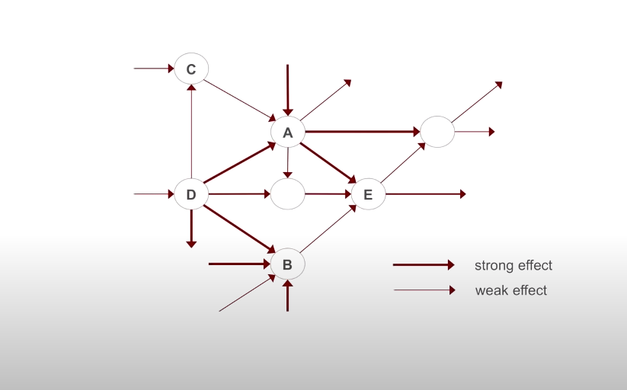

Slide 63
The nature of management is complex: Mintzberg’s roles

Slide 64
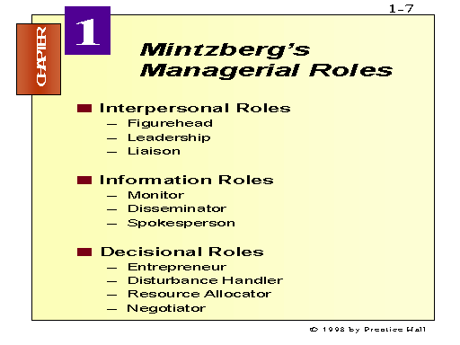

Slide 65
Innovation requires idle time
Managers are too busy to think about new processes for climate change

Slide 66
There was a famous “scientist” in ancient Greece who pondered over a scientific problem. One fine day, while in his bath tub, he had this flash of inspiration! Who was he?

Slide 67
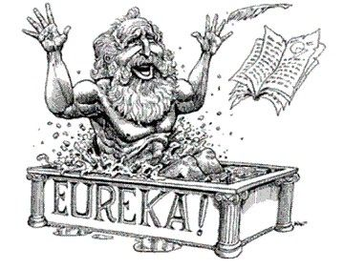

Slide 68
3 Bs

Slide 69
There is always a temptation for short-termism

Slide 70
Career planning and human motivation
Most managers are thinking about the next 3 to 5 years for professional and personal goals

Slide 71
There are some notable exceptions
Paul Polman: 3 Ps
Stopped giving quarterly guidance to the financial press
Compensation systems were focused on 10 year goals

Slide 72
Focus
Business logic: the financial health of the firm and its financial reporting obligations
Environmental logic : environmental issues cannot be measured in economic terms as the issues of social , scientific and moral rather than economic

Slide 73
As you move up the hierarchy the weight of financial issues becomes larger

Slide 74
Initiatives such as the United nations Global Compact in 2000 have led a number of firms to publicly embrace the idea of the triple bottom line.
But change has been slow

Slide 75
In economics, the triple bottom line (TBL) maintains that companies should commit to focusing as much on social and environmental concerns as they do on profits
3 Ps

Slide 76
Sarbanes- Oxley Act: Places fiduciary responsibility on senior management and the board.
The focus is on financials

Slide 77
Risk
Business logic: risk is unavoidable and can be managed by evaluating its probability
Environmental logic: catastrophic risk is unacceptable and should be eliminated

Slide 78
Many industrial processes have risks: oil processing can be toxic but business has developed control mechanisms to minimise risks
Disasters have happened in the past and likely to happen in the future

Slide 79
Environmentalists on the other hand take the view that some risk should not be considered at all, like the use of nuclear energy
Tobacco ought to be banned completely
Perhaps in the future: alcohol

Slide 80
Arguably, the risks are a price to pay for progress and innovation-
E.g. Covid vaccines have risks: it will take too long to eliminate these risks completely before use

Slide 81
The role of the government
Business logic: the government is the embodiment of the will of the people and sets the rules for business through the political process.
Environmental logic: The political process is heavily influenced by business, and government cannot be trusted to protect the environment.

Slide 82
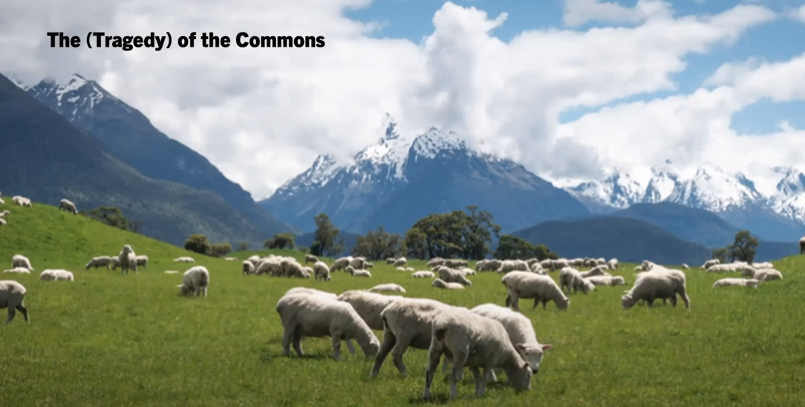

Slide 83
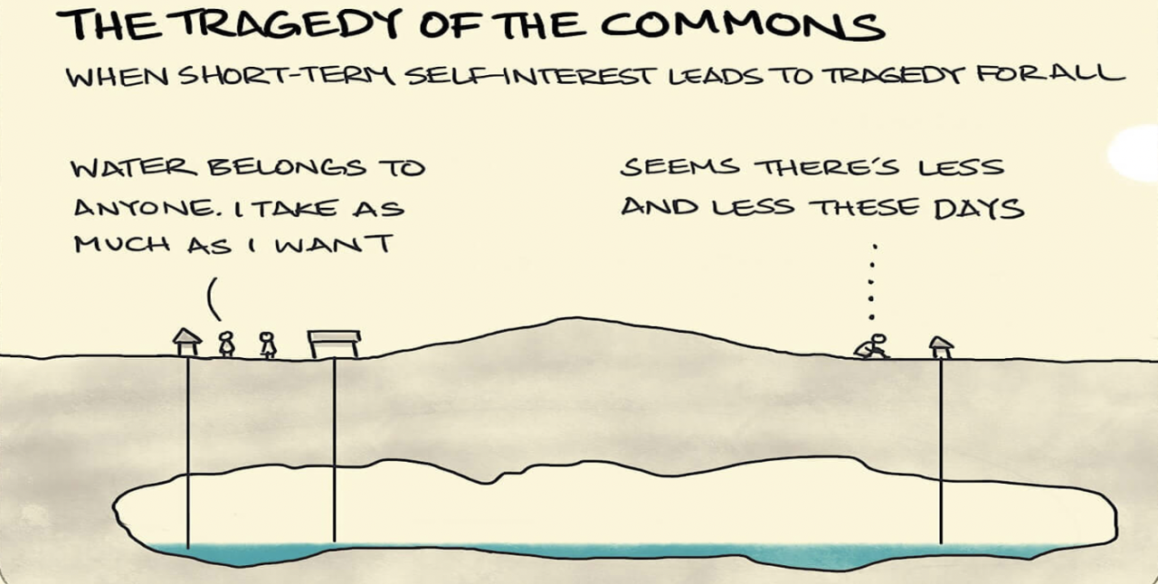

Slide 84
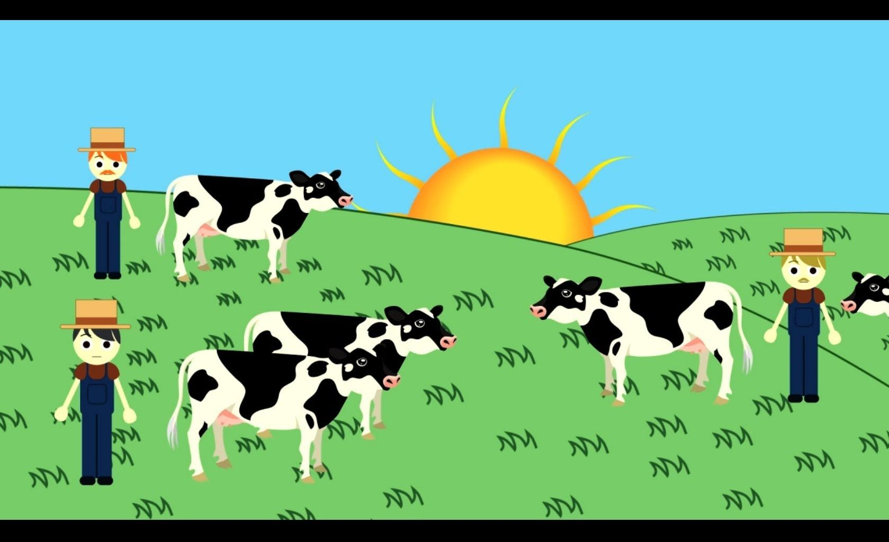

Slide 85


Slide 86
Hardin maintains that there will always be people who placed the self interest above that of the community.
People who voluntarily curb the behaviour will feel taken advantage of
Why are people angry about Partygate?

Slide 87
The business community is not averse to government intervention
But we should roll back the influence of the state
flexible markets

Slide 88

The Gilets Jaune

Slide 89
Environmentalists are sceptical about the role of a government
They are mouthpiece of the business community

Slide 90
Purpose
business logic the purpose of business is to make money for its shareholders
environmental logic the purpose of human activity is to be in harmony with the natural environment

Slide 91
The World has been caught off guard
20th Century has been tumultuous:
In what way ?

Slide 92
First and Second World War: Mustard gas, massive artillery bombardments, oil power mechanisation on land, at sea and in the air, atomic bomb attacks
Industrialization accelerated

Slide 93
The last 60 years
after the Second World War the world entered into a period of unprecedented economic growth
advances in chemical engineering, metallurgy, electronics, an other technologies fuelled largely by oil and coal.

Slide 94
We’ve enjoyed:
Washing machines, dishwashers, lawn mowers, television, air travel
Electronics, digital products
Artificial Intelligence in the future

Slide 95
Pollution called “killer fogs” killed 20 people in 1948 in Pennsylvania
1950 22 people died in Mexico

Slide 96
1950s
Just two years later, 4000 people died over a four day in London.
In 1952 hundreds perished in New York City
In 1953 and another 1000 lost their lives
In Los Angeles another 56

Slide 97


Slide 98
1950s the first public reactions to the testing of nuclear weapons
Hippie and anti-war movements in many cities
Massive student strikes in Paris in 1968

Slide 99


Slide 100
1970
The Environmental Protection Agency and the National Oceanographic
Limits to Growth

Slide 101
1980s marked by many large scale environmental disasters
Gas escape at union carbides plant in Bhopal India
Nuclear power accident of Chernobyl
Etc etc

Slide 102


Slide 103
The Modern Slavery Act 2015 ("the Act") introduces a number of measures to combat slavery and human trafficking. In addition to creating new criminal offences, powers of enforcement and measures to protect victims, it introduces requirements intended to eliminate slavery and trafficking in global supply chains.

